Slide 1
Integrated Medical Biochemistry
Prof. Orhan Canbolat MD., PhD
https://avesis.gazi.edu.tr/ocanbolat https://yasam.gazi.edu.tr www.profdrorhancanbolat.com Prof. Dr. Orhan Canbolat – Youtube Prof. Dr. Orhan Canbolat‬ - ‪Google scholar https://www.scopus.com

Slide 2


Slide 3
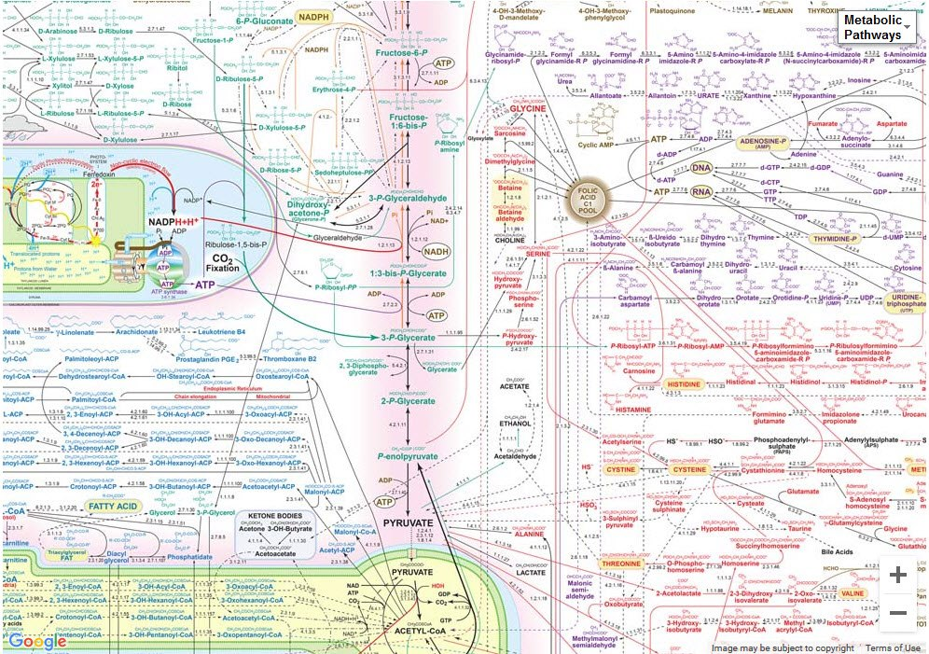
METABOLIC PATHWAYS
Break it up into small pieces and then put them together -René Descartes

Slide 4
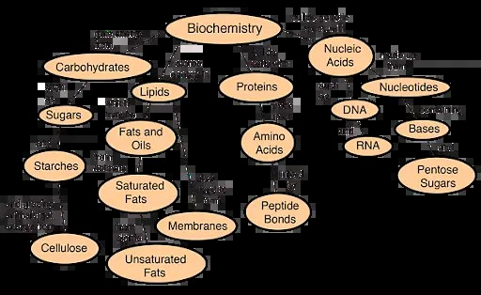
Lehninger Principles of Biochemistry
Harper's Illustrated Biochemistry
Lippincott Illustrated Reviews: Biochemistry

Slide 5
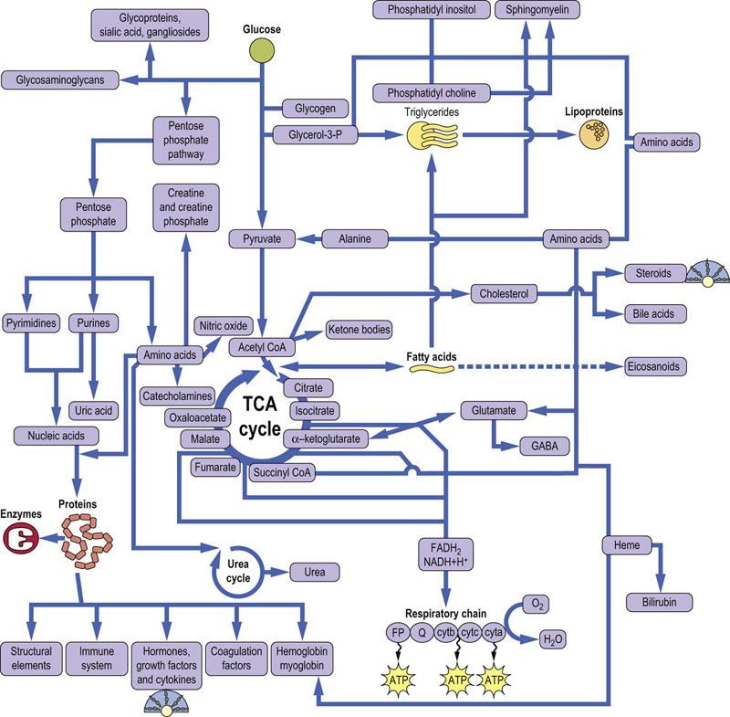

Slide 6
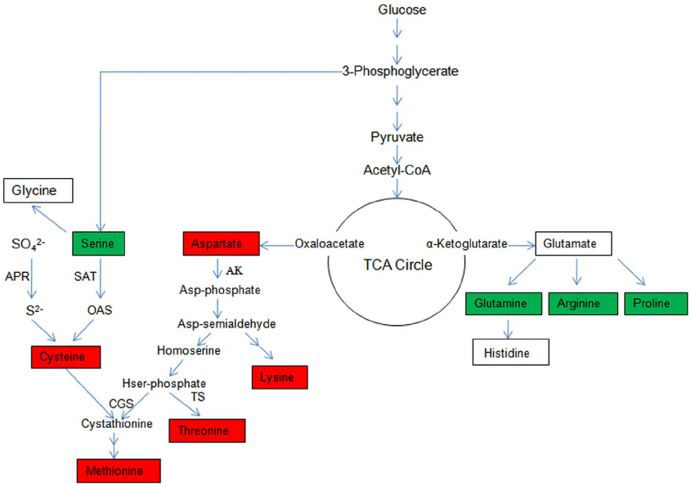

Slide 7
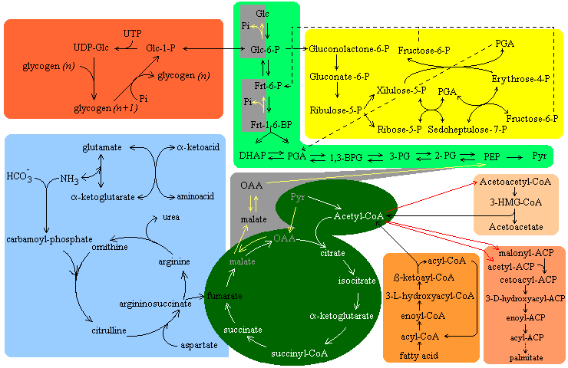
NADH+H
FADH2

Slide 8
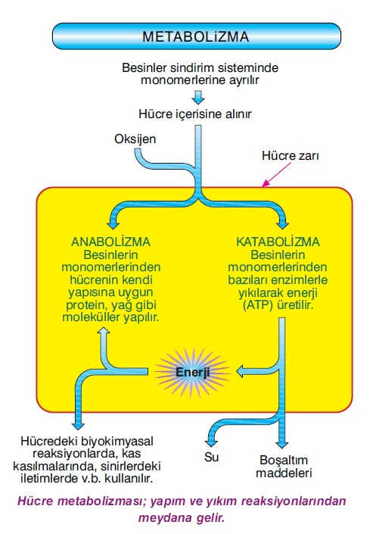
DÜZEN- KAOS YAPIM - YIKIM
,
OX-FOS

Slide 9
DÖNGÜ
NADH+H/ NAD
ATP/ ADP
O2

Slide 10
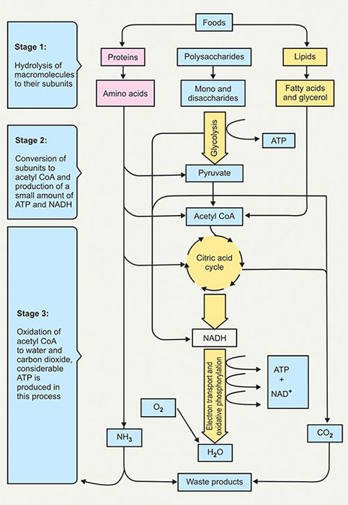
energy metabolism
Oxygen metabolism
Hemoglobin structure
and function

Slide 11
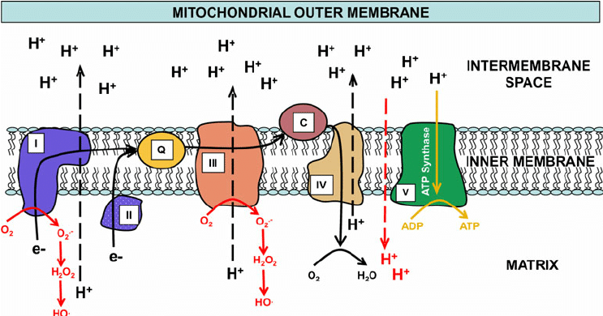
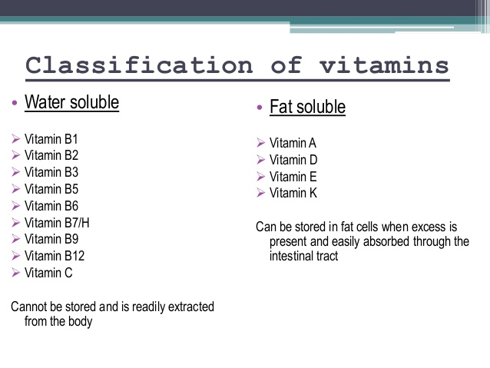
Oxyhemoglobin is formed during physiological respiration when oxygen binds to the heme component of the protein hemoglobin in red blood cells.
CH, LP, Aa NADH+H , FADH2
NADH+H ,FADH2
’
E= Protein+ceenzyme+ Co factor
SAS

Slide 12
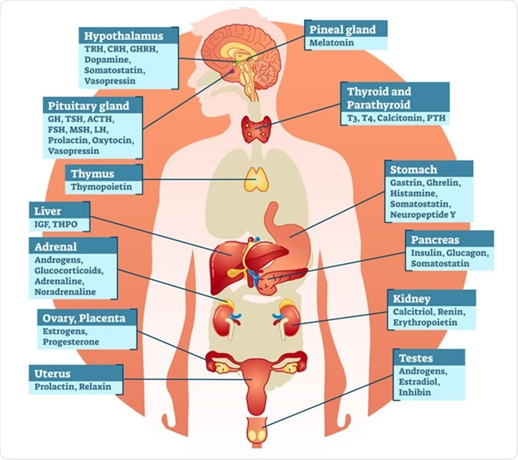

Slide 13
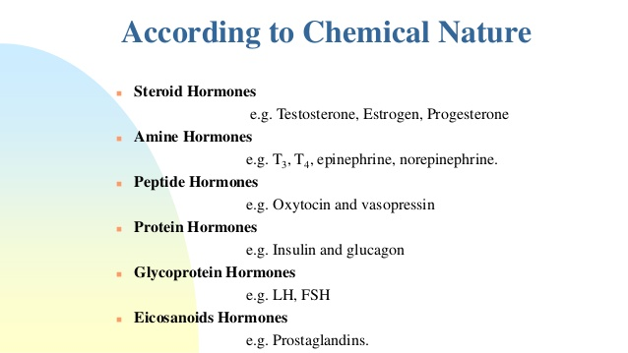

Slide 14
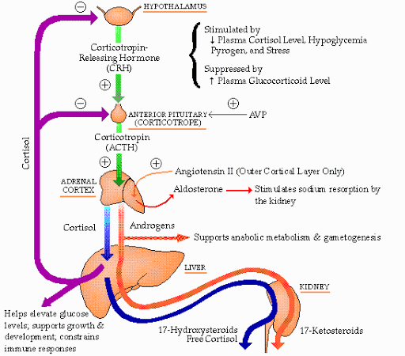
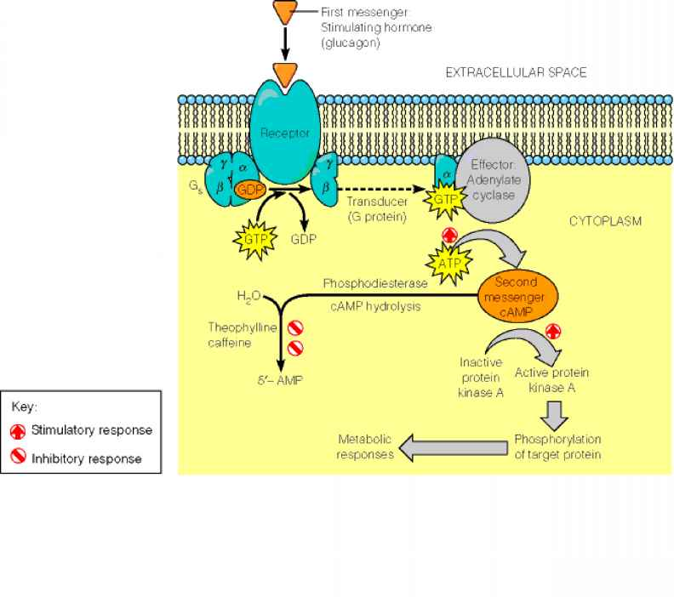
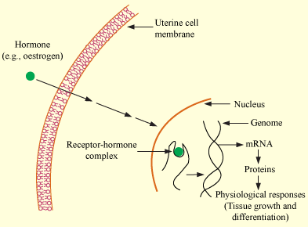

Slide 15
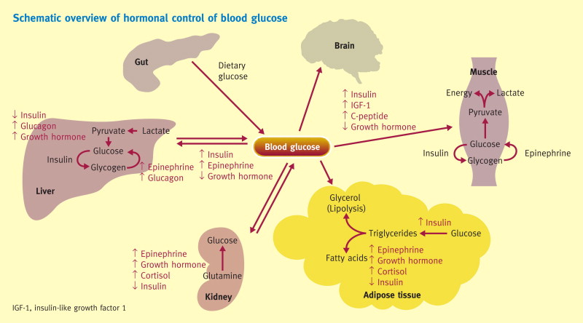
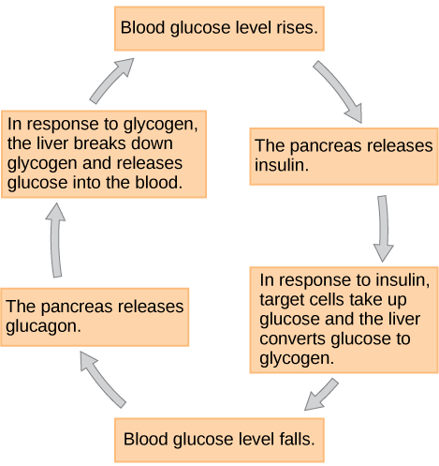

Slide 16
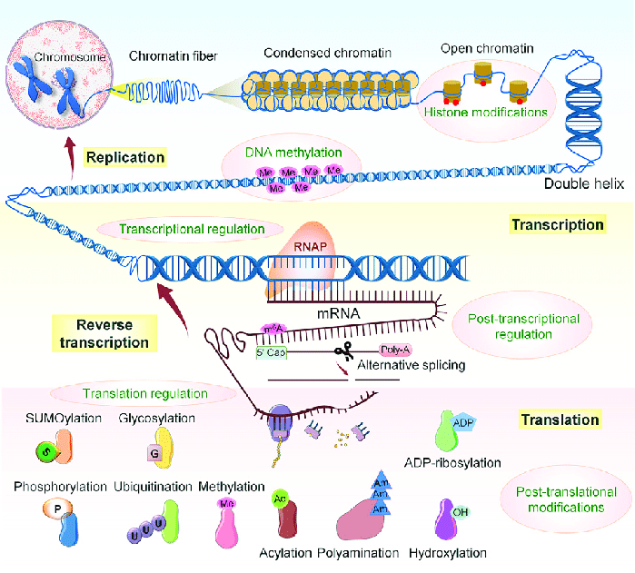

Slide 17
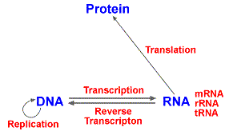
genetic information
NUCLEOTİDE METABOLİSM
Amino acid metabolism
Pentose phosphate Patway
Vitamin
Energy Metabolism
Enzyme and enzyme kinetics

Slide 18
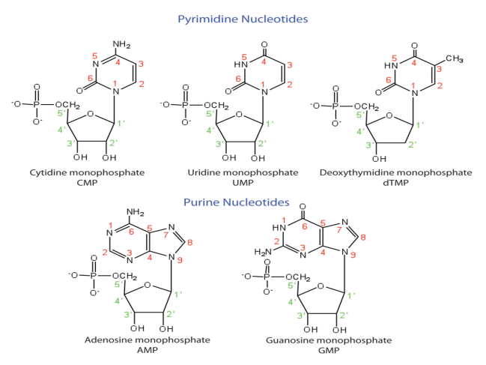
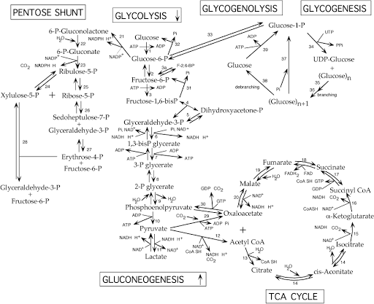
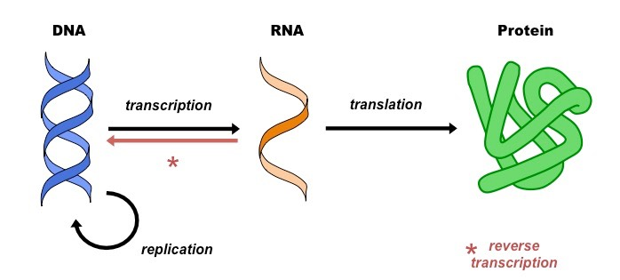
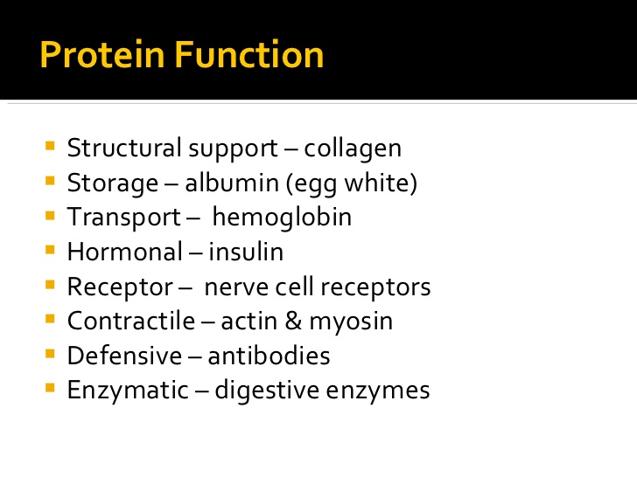
AMİNO ACİDS -glutamate-glycine- aspartate
SAS- GTP
ENZİMLER

