Slide 1
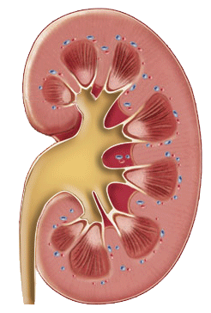
KIDNEY FUNCTION TESTS
Prof. Dr Orhan CANBOLAT

Slide 2
Why Test Kidney Function?
*To identify renal dysfunction.
*To diagnose renal disease.
*To reveal the principle site of pathology
*To assess the degree of functional damage
*To monitor disease progress.
*To monitor response to treatment.

Slide 3
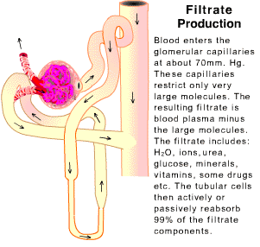
Kidney Function Tests
The main task of the kidneys is to maintain homeostasis in the body.
Water Metabolism
Electrolyte and Acid-Base Balance
Excretion of Metabolic Products
Endocrine Role
Monitoring of kidney functions is important to follow other organ functions.
In case of clinical impairment of kidney functions, nephrons may have lost their functions at a rate close to 30-50%

Slide 4
WATER METABOLISM
Urine = 1% of Ultrafiltrate
Urine ; 400- 25.000 ml / day ??
End product of proteins and nucleic acids lead to solute loading. Mainly urea, sodium, chlorine, potassium, creatinine and ammonia solutes are found in urine.
On the contrary, substances such as glucose and protein, which are the major needs of the body, are not included in the urine except for illness.
Urine, which is effective in maintaining the balance of the body, is usually acidic. Depending on the foods eaten and drunk during the day, this pH value can vary between 4.7 and 8.4.
The first deteriorating feature of the kidney is its ability to concentrate.
Final products; Uric acid, urea, creatine lead to solute overload
We need water for the excretion of Lactate, Beta hydroxy butyrate.
DM (glucose) causes the most solute loading

Slide 5
WATER METABOLISM
For a suitable concentration ability;
Glemerular filtration rate ; N
Renal plasma flow velocity:N
Kidney cells must be normal
Antidiuretic hormone (ADH), also known as vasopressin, is a hormone released from the hypothalamus and posterior pituitary gland.
The antidiuretic hormone mainly enhances the reabsorption of water. Central diabetes insipidus (SDI) is caused by vasopressin (antidiuretic hormone) deficiency =POLYUREA
Osmolarity is defined as the amount of dissolved particles in 1 liter of solution. shown as osmol / Lt.- Glucose, Na,Cl
Urinary density; 1.003 - 1.025
It depends on the solids dissolved in the urine.
Easy to measure
Gives general information
Serum Osmolarite Normal Value: 275-295 mOsmol / L
In cases where serum osmolarity decreases, ADH secretion is suppressed and serum osmolarity is brought to normal by increasing urine output.

Slide 6
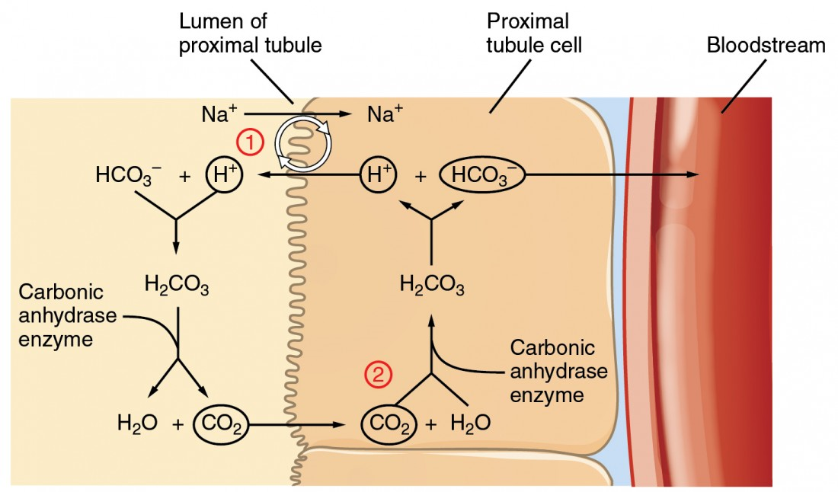
Electrolyte - Acid-Base Balance
Acid-base homeostasis and pH regulation are critical for both normal physiology and cell metabolism and function
In acid-base balance, the kidney is responsible for 2 major activities:
-Reabsorption of filtered bicarbonate
-Excretion of the fixed acids
Proximal Tubulus; Cl, Na; K, HCO3, Ca, P reabsorption
Distal Tubulus; K +, H secretion, Na, HCO3 uptake
Kidneys and lungs play a central role in maintaining acid and base balance.

Slide 7
Excretion of Metabolic Products
The end products of protein, fat metabolism, nucleotide metabolism are carbon and nitrogen-based compounds. Kidneys play a key role in removing these end products.
There is no recycling
They are soluble in water
Has a toxic effect
Special diet for kidney patients depends on the structural properties of the final products.
Sugar, Aa Urea, Electrolyte, HCO3,H Creatinine

Slide 8


ENDOCRINE ROLE
PRODUCTION
Vasopressin- ADH ; Water retention – Blood pressure increased
Aldosterone ; Sodium Retation – Water retention
Renin; Angiotensin II Vasoconstriction,
Release Vasopressin ,Aldosterone
Atrial Natriuretic Factor ; vasodiladation, increased GFR
Erytropoetin ; Decreased RBC– Decresased Po2 – EPO RBC
Activation of vitamin D; Calcitriol ,
Ca+ metabolism regülation, reabsorption
BREAKDOWN
Insulin, Glucagon, Aldesteron

Slide 9
MONITORING KIDNEY FUNCTIONS
Glomerular filtration rate
Protein
Urea
Uric acid
Osmolarity
Electrolytes
Easy, Cheap
It does not describe the location of the pathology and the Etiology
Alerts kidney disease or a systemic disease

Slide 10
GLOMERULAR FİLTRATİON RATE
Creatinine Clearance
It is defined as the quantity of blood cleared of a substance per unit time and depends on the plasma concentration of the substance and excretion rate of the kidney which reflects GFR and renal plasma flow.
The gold standard of direct GFR measurement is inulin clearance measurement. Exogenous and it is not suitable for daily applications as it requires complex and difficult laboratory methods.
Endogenous creatinine clearance is a generally accepted method. It may give incorrect results in decreased renal functions as it is secreted from tubules.
CREATİNİNE CLEARANCE is a measure of the glomerular filtration rate.
Urine and serum creatinine levels are measured and the creatinine clearance rate is calculated.
Endogenous
It will not be metabolized in the body
Must be filtered from glomeruli
No reabsorption from tubules

Slide 11
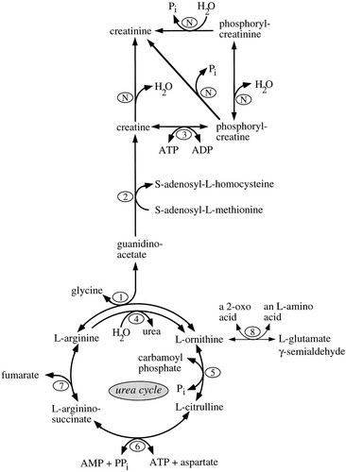
GLOMERULAR FİLTRATİON RATE- CREATİNİNE
Shows the kidney's ability to concentrate
E. 0.9- 1.5 mg / dl (serum)
K: 0.7 - 1.3 mg / dl (serum)

Slide 12
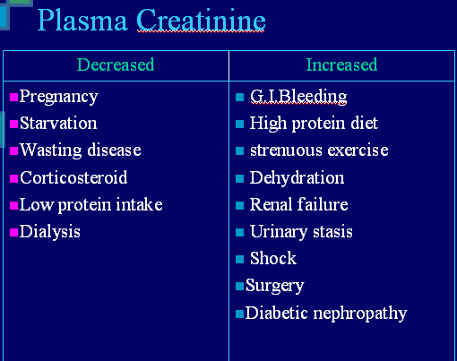
Creatinine is mainly derived from the metabolism of creatine in muscle, and its generation is proportional to the total muscle mass. As a result, mean creatinine generation is higher in men than in women, in younger than in older individuals, and in blacks than in whites. This leads to differences in serum creatinine concentration according to age, gender, and race, even after adjusting for GFR.

Slide 13
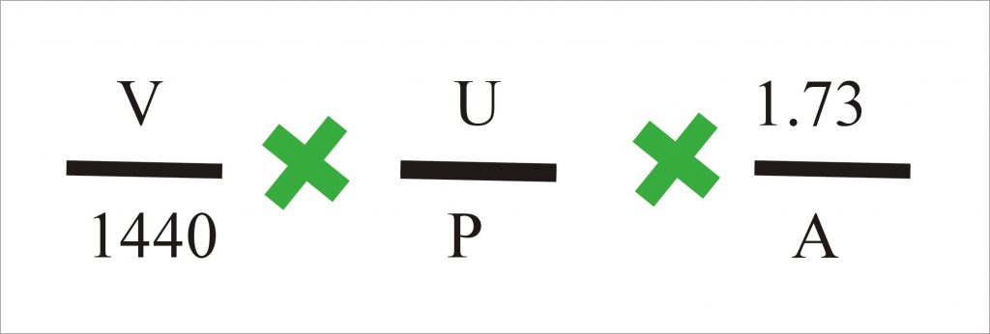
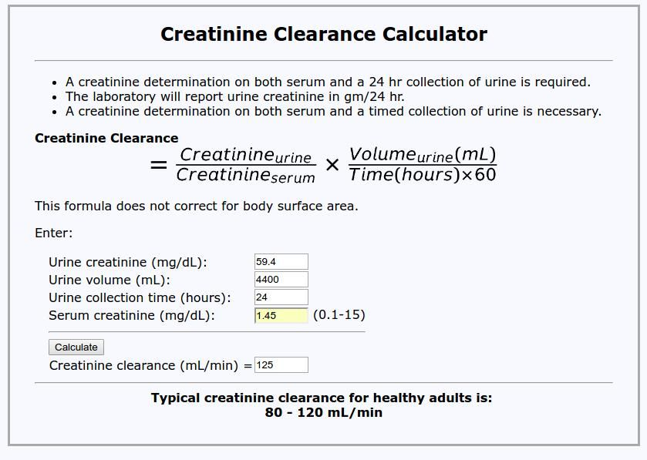
U = number of mg /dL of creatinine excreted in the urine in 24 hours.
V = volume of urine in mL per minute.
P = serum creatinine mg/dL.
1.73/A is a body surface area.

Slide 14
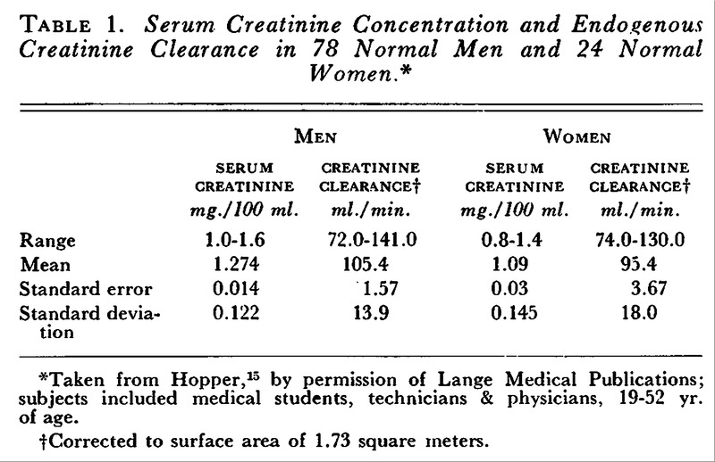

Slide 15
CREATİNİNE CLEARANCE
Increased Values:
This has no clinical significance, suspect some error in the collection procedure.
  Pregnancy
  Exercise.
  High cardiac output syndrome.
Decreased Values:
it is a very sensitive indicator of decreased glomerular filtration rate.
  Diseases of the kidney with impaired renal function.
  Congestive heart failure.
  Cirrhosis with ascites.
  Shock.
  Dehydration (loss of body fluids).
  Bladder outlet obstruction.

Slide 16
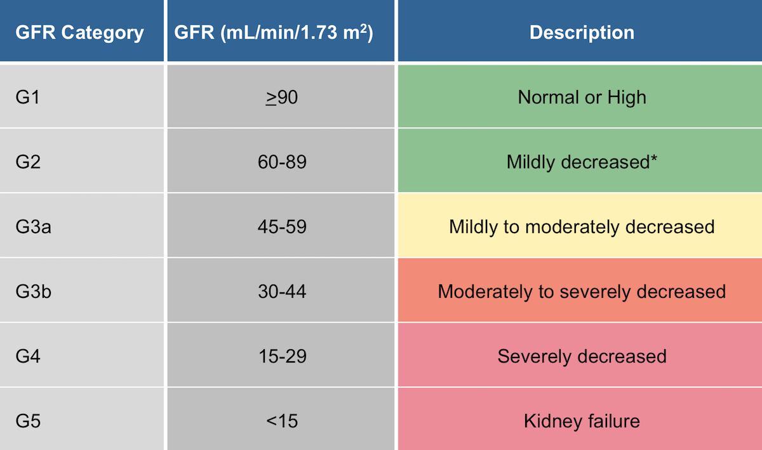
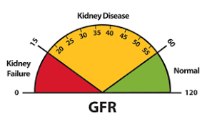

Slide 17
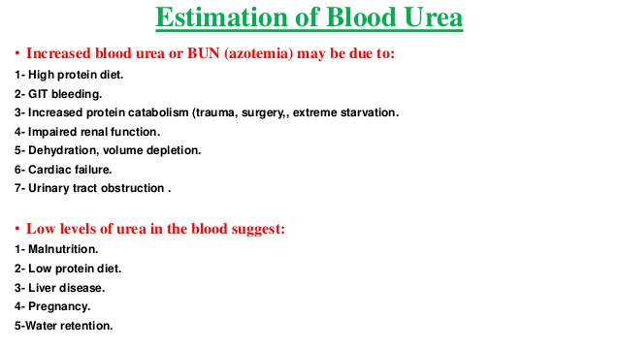
UREA
In humans and mammals, almost 80% of the nitrogen excreted is in the form of urea, which is produced through a series of reactions occurring in the cytosol and mitochondrial matrix of liver cells. Ammonia is a toxic product of nitrogen metabolism that should be removed from our body. The urea cycle converts excess ammonia into urea in the mitochondria of liver cells. The urea forms, then enters the blood stream, is filtered by the kidneys and is ultimately excreted in the urine.

Slide 18
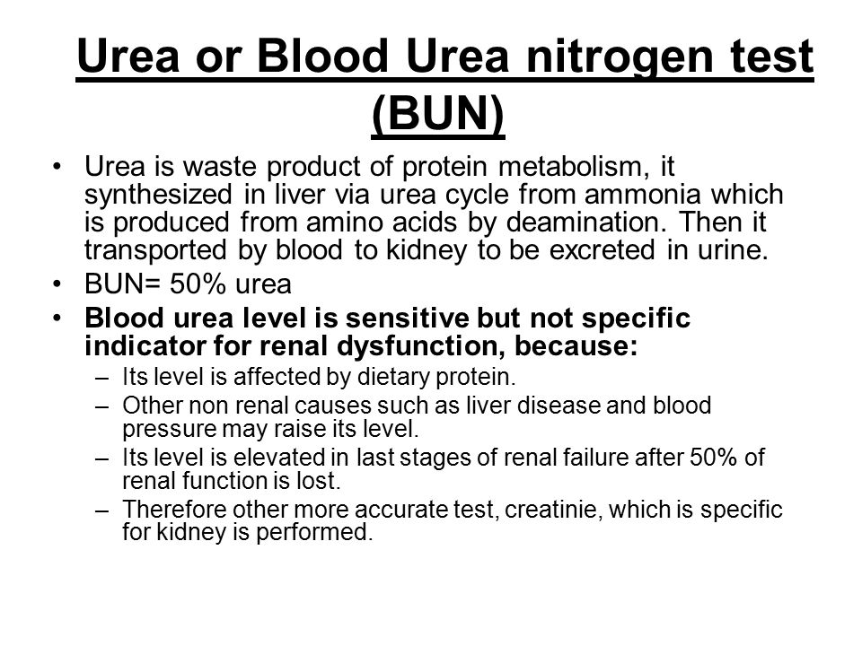
BLOOD UREA NITROGEN
Blood urea molecule: O = C = ( NH2 )2 .
Urease enzyme can split urea into ammonia and carbon dioxide.
The molecular weight of urea = 60 grams
Each molecule contains nitrogen = 28 grams. This is called blood urea nitrogen (BUN).
  The serum concentration of 28 mg/dL of urea – nitrogen is equivalent to 60 mg/dL of urea or 10 mmol/L of urea or urea-nitrogen in SI units.
The measurement of urea nitrogen gives an idea of the ratio between excretion and production of urea.

Slide 19
BUN/Creatinine Ratio
Normal
BUN / creatinine ratio = 10 :1 = 6 to 25
  optimum adult level = 15.5
BUN/Creatinine Ratio Is Raised, This Is Suggestive Of:
Prerenal azotemia:
  There is poor renal perfusion like hypovolemia or hypotension.
Postrenal azotemia:
  Seen in congestive heart failure.
  Urinary tract obstruction.
  Gastrointestinal bleeding.
  Trauma.
BUN/Creatinine Ratio Is Decreased Suggestive Of:
This is rare and seen in:
  Dietary protein deficiency
  Severe liver disease

Slide 20
PROTEINURIA
It is the most specific in identifying kidney diseases
Under normal conditions, urine does not contain protein.
Trace amounts of protein may be present at the level of 30mg / day in the urine.
A condition where the amount of protein in the urine is 30-300 mg / day is defined as micro albumin. Micro albuminuria may be the first sign of glemerulpathology.

Slide 21
PROTEINURIA
1.GLEMERULAR PROTEİNURİA = Albuminuria, the most common
Diffuse kidney diseases = Diabetes
Immune complex diseases = Nephrotic Syndrome, Pyelonephritis
Daily protein consumption is over 1 gram
2.TUBULAR PROTEİNURİA
Aminoacituries, Lysine, Arginine, Cysteine
Burn, Pancreatitis,
Nephrotoxic drugs
Absorption disorder of small protein structures
3.OVERPRODUCTİON PROTEİNURİA
Multipl Myeloma; Ben Jones Proteinuria
4.POSTRENAL PROTENURİA
Bladder Diseases; Inflammation, stone, tumor
Nephrotic syndrome is characterized by large amounts of proteinuria (>3.5 g per 1.73 m² body surface area per day, hypoalbuminemia (< 2.5 g/dl), hyperlipidaemia, edema
Acute glomerulonephritis (AGN) with sudden onset of macroscopic hematuria, proteinuria, oliguria, azotemia, edema and hypertension

Slide 22
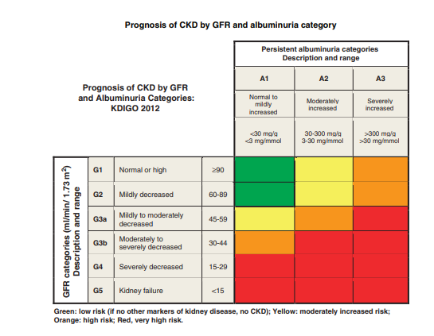

Slide 23
URIC ACID
Purine metabolism end product,
Non-specific
Causes gout
4.5-7.5 mg / dl / day
Hyperuricemia
1. Essential; overproduction, reduction of emissions
2.Nucleic acid turn-over increase
3. Enzymatic defects; Lesh - Nyhan Syndrome, PRPP synthetase activity increased
4.Kidney Failure
5.Lead toxicity
6.Diuretics
Hypouricemia
1.Xo enzyme defect
2.Hepatocellular diseases
3.Radio opaque materials
Drops below 2 mg / dl / day

Slide 24
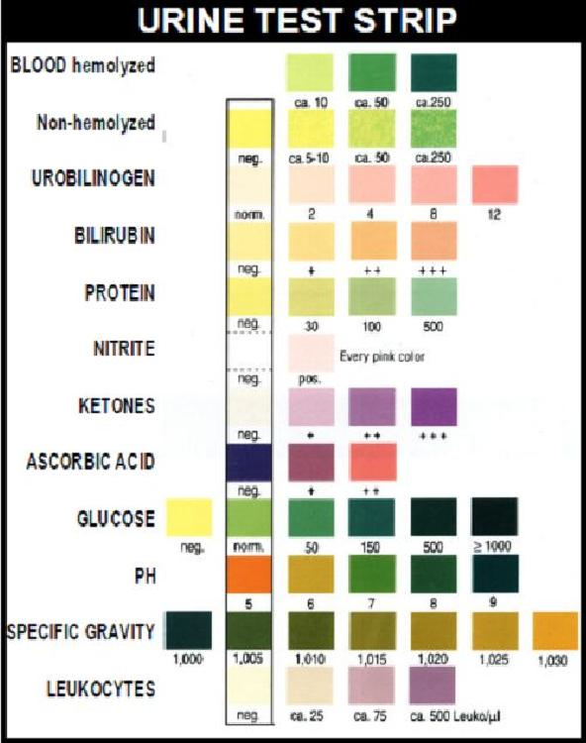
A standard urine test strip may comprise up to 10 different chemical reagents.The test can often be read in as little as 60 to 120 seconds after dipping. Routine testing of the urine with multiparameter strips is the first step in the diagnosis of a wide range of diseases. The analysis includes testing for the presence of proteins, glucose, ketones, haemoglobin, bilirubin, urobilinogen, acetone, nitrite, leucocytes, pH and specific gravity for kidney function

